Slide 1
CSE5095-002: Topics in Software Defined Networking
Lecture 5
Minmei Wang
Computer Science and Engineering

Slide 2
B4: Experience with a Globally-Deployed Software WAN
Sushant Jain, Alok Kumar, etc.
SIGCOMM 2013

Slide 3
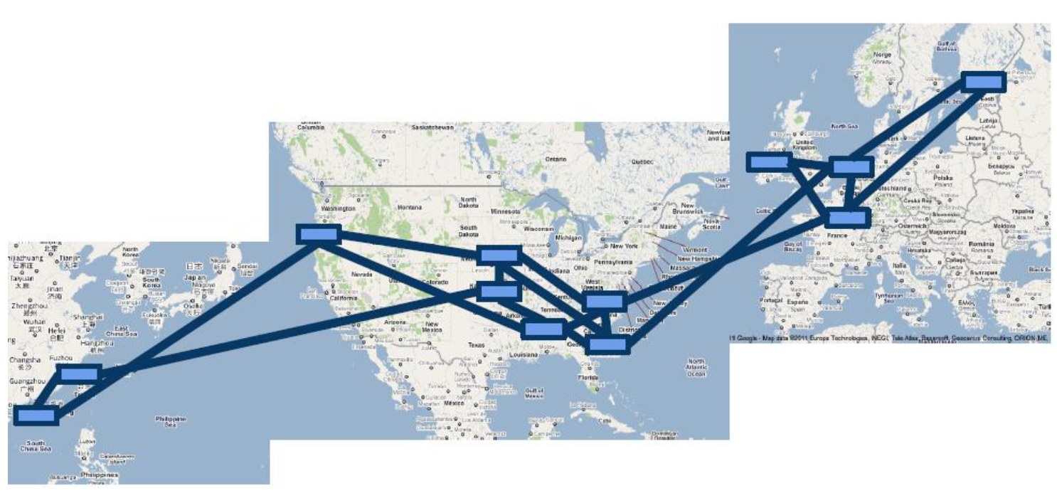
B4: Google’s Software Defined WAN

Slide 4
Applications run across B4
Type1 : User data copies to remote centers
Email, documents, audio/video files
Type 2: Remote storage access for computation over inherently distributed data source
Type 3: Large-scale data push synchronizing state across multiple data centers
Decreasing overall priority
Decreasing latency sensitivity
increasing volume

Slide 5
B4: Google’s Software Defined WAN
Google’s private WAN connecting its data centers
Elastic bandwidth demands
Can tolerate periodic failures with temporary BW reduction
Small number of sites
Allows special optimization
Complete control of end application
Application priorities and control bursts at the network edge
Cost Sensitivity
Unsustainable cost projection with traditional approach (30%-40% utilization rate, 2-3x cost of a fully utilized WAN).

Slide 6
B4 design decisions
B4 routers built from merchant switch silicon
APPS trade bandwidth for fault tolerance
Edge control →reduced the buffer size, number of B4 site → small forwarding table
Low router cost → scale network capacity
Drive links to 100% utilization
Effective use of expensive long haul transport
High average bandwidth over predictability: largest bandwidth consumers can adapt to bandwidth availability
Centralized traffic engineering
Multipath
Application classification and priority
Improved over traditional TE schemes
Faster, deterministic global convergence for failures
Separate hardware from software
Customized routing
Rapid iterating of software protocols
Easier to protect against common case software failures
Agnostic to range of hardware deployment

Slide 7
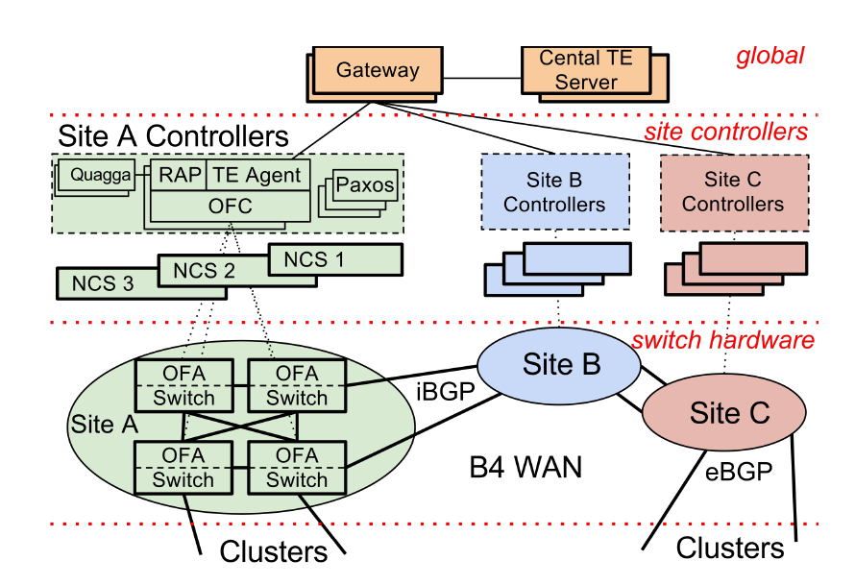
Overview
Logical centralized applications
three layers
NCS: network control servers

Slide 8
B4 SDN architecture
Switch hardware (Google custom designed with commodity silicon)
Forwards traffic
No complex control software
OpenFlow controllers (OFC – ONIX based)
Maintain network state based on network control application directive and switch events
Instruct switches to set forwarding entries
Central application
Central control of the entire network

Slide 9
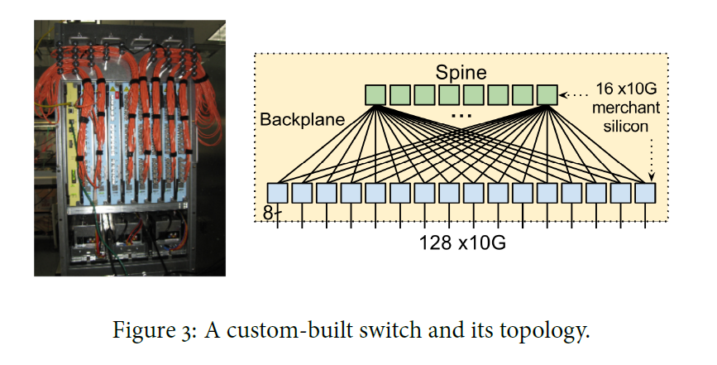
Design
Switch
OpenFlow Agent (OFA)
Linux operating system
Low-level control over switch forwarding behaviors

Slide 10
Network control functionality
Runs on NCS in the site
Paxos for leader election
Modified ONIX for OpenFlow control
Network information Base (NIB)
Topology, trunk configuration, link status.
Static state from local configuration, dynamic network state by synchronizing with switches

Slide 11
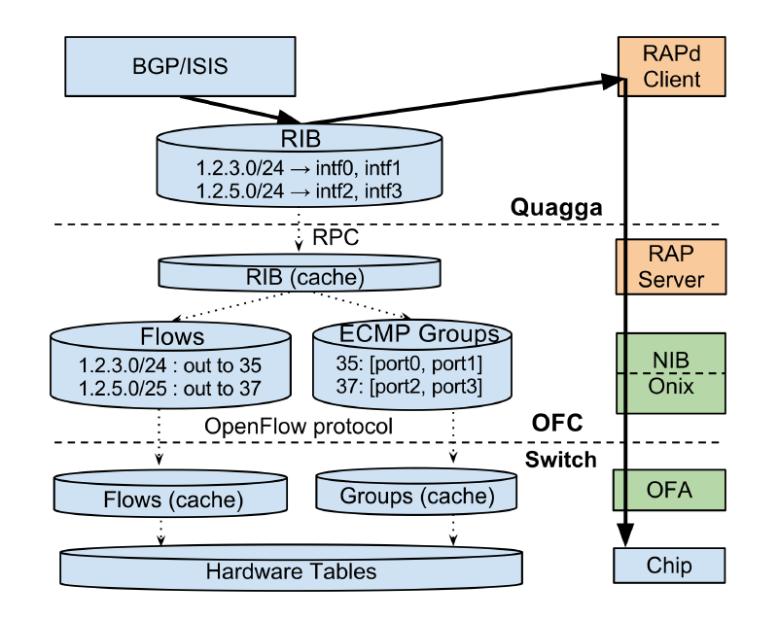
Routing
RAP: routing application proxy
RIB: routing information base
Quagga: software package
Integrate routing protocols
BGP/ISIS route updates
Routing protocol packets flowing between switches and Quagga
Interface updates from the switches to Quagga
ECMP: equal-cost multi-path routing

Slide 12
Interface and port state change
1) Switch OFA sends an OpenFlow message to OFC
2) OFC updates local NIB, then propogates to RAPd
3) RAPd changes the netdev state for each interface change
4) Changes are then propagated to Quagga for routing protocol updates

Slide 13
Overview
Share bandwidth among competing applications possibly using multiple paths
Logical centralized applications

Slide 14
Traffic Engineering (TE)
TE server operates over the following state
Network topology
SDN gateway consolidates topology events from multiple sites and individual switches to TE
Flow Group (FG)
Aggregate applications to a Flow Group
{source site, dest site, Qos}
Tunnel (T)
Tunnel group (TG)
Map FGs to a set of tunnels and corresponding weights

Slide 15
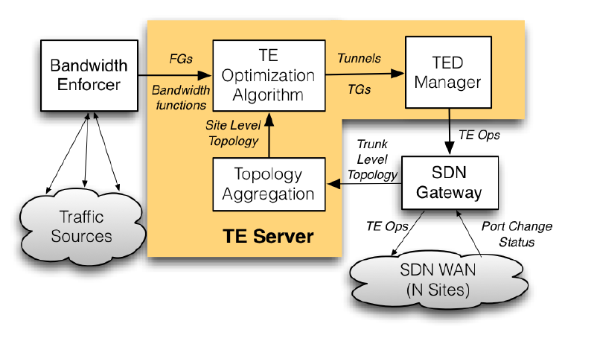
Traffic Engineering (TE)
Bandwidth allocation

Slide 16
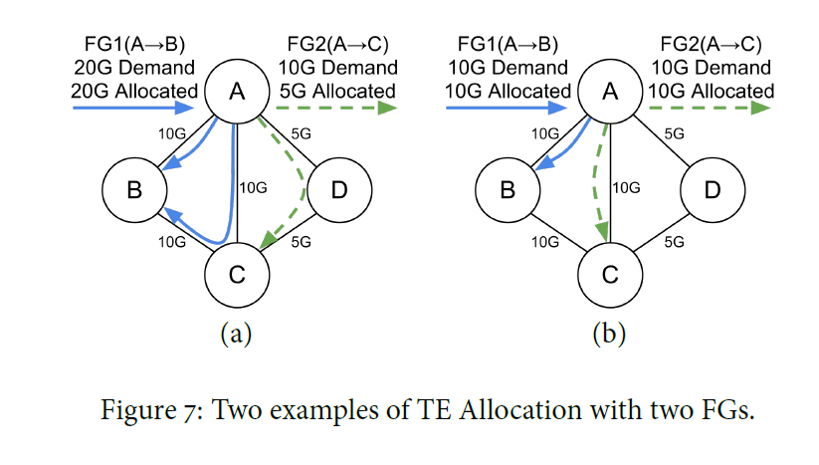
Traffic Engineering (TE)
The TE optimization algorithm determines the tunnels and corresponding allocated bandwidth

Slide 17
How to convert Tunnel Groups, Tunnels, and Flow Groups to OpenFlow state?

Slide 18
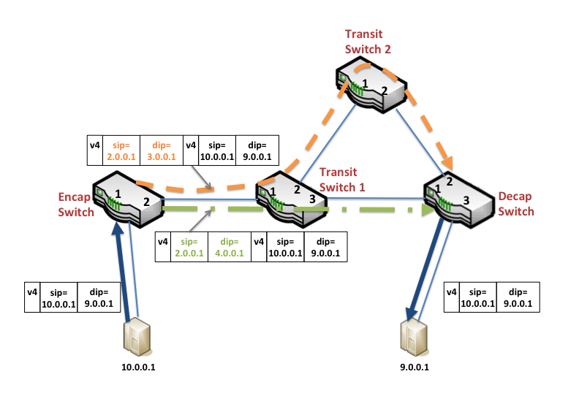
TE state
B4 switch
Encapsulating switch
Choose a tunnel from TG
Encapsulate the packet
Transit switch
Per-tunnel forwarding rule
Decapsulating switch
Decapsulate the packet

Slide 19
Composing routing and TE
B4 supports both Shortest-path routing and TE
Shortest-path routing
LPM table
TE
Access control list (ACL) table
ACL rules takes strict precedence over LPM entries

Slide 20
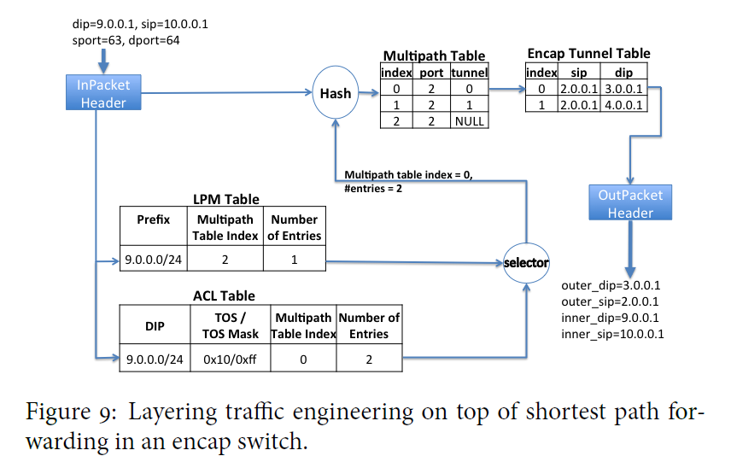
Composing routing and TE

Slide 21
Overview
Share bandwidth among competing applications possibly using multiple paths
Logical centralized applications

Slide 22
Coordinating TE state across sites
Multiple OFCs
TED maintains a key-value datastore for global Tunnels, TG, FGs
Identify entries requiring modification
Generate a single TE op for each difference
OFC converts TE op to flow-programming instructions
OFC waits for ACKs

Slide 23
Dealing with operation dependency
Network configuration operations must be issued in some order to avoid packet drops
Rules:
Configure a tunnel at all affected sites before sending TG and FG
A Tunnel cannot be deleted until all referencing entries are removed.
Enforcing dependencies
OFC maintains the highest session sequence number
OFC rejects operations with smaller sequence number
TE server retries any rejected ops after a timeout

Slide 24
Dealing with failures
TE periodically synchronizes state to a persistent store to handle simultaneous failures
A TE op failure
RPC failures, OFC rejection, problem of a hardware device
Solution: use a bit to track each TED entry
Mark when issuing a TE op, clean upon receiving acknowledgement from the OFC

Slide 25
Advantage of Centralized TE
Better network utilization with global pictures
Converges faster to target optimum on failure
Allows more control and specifying intend
Can mirror production event streams for testing
Controller uses modern server hardware – better performance (50x!)

Slide 26
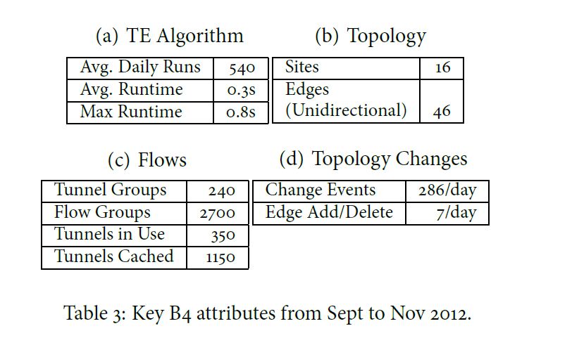
Experiments

Slide 27
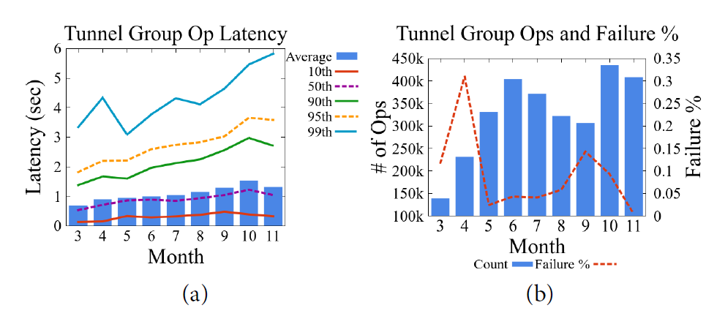
Experiments
Stats for various TE operations for March-Nov 2012

Slide 28
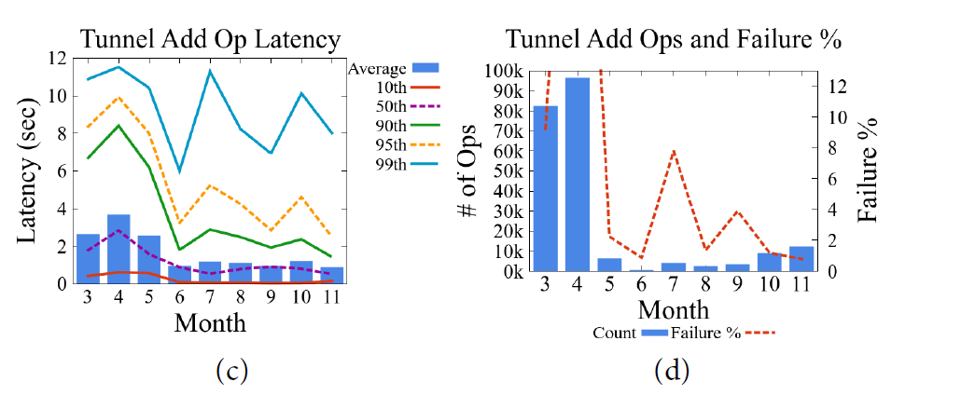
Experiments
Stats for various TE operations for March-Nov 2012

Slide 29
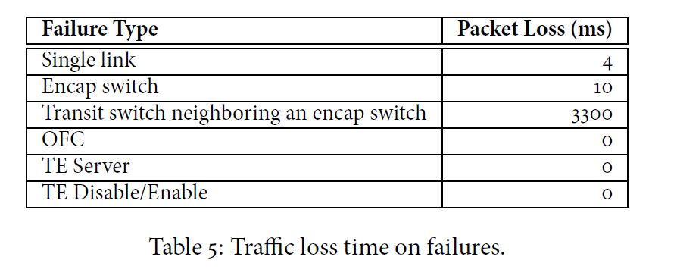
Experiments
Prune ECMP groups that include the impaired link
The neighboring Switch has to update its multipath table entries for potentially several tunnels that were traversing the failed switch

Slide 30
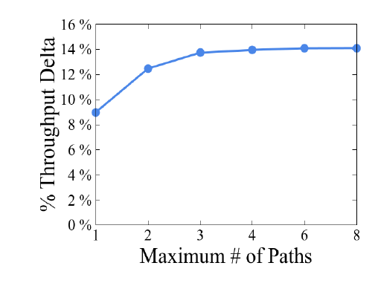
Experiments
TE global throughput improvement relative to shortest-path routing
The throughput improvement fattens at around 4 paths.

Slide 31
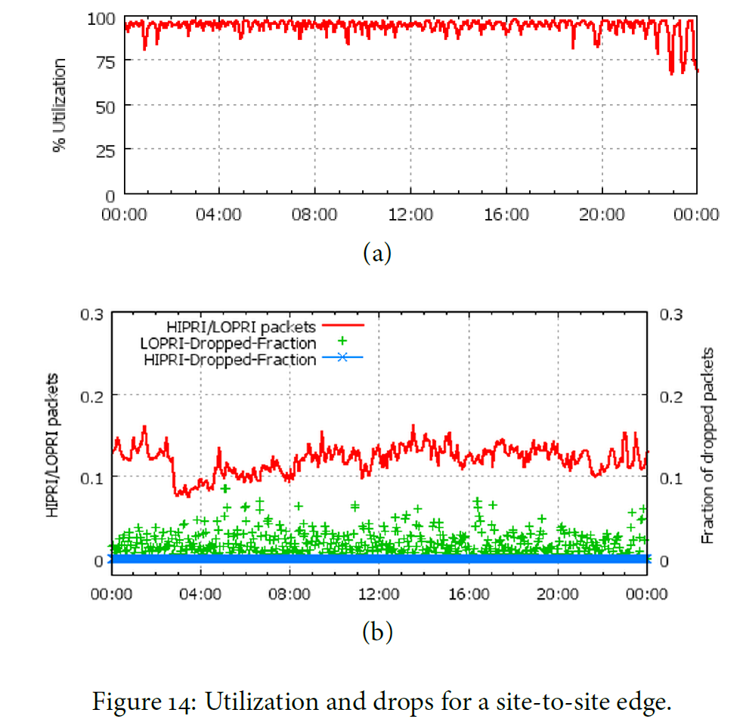
Experiments
B4 achieves almost 100% link utilization

Slide 32
Conclusions
Supporting both existing routing protocols and novel traffic engineering services demonstrates an effective technique for SDN based network
Leveraging control at the edge to measure demands and manage traffic for different applications based on relative priority increases WAN utilization and improves failure tolerance.

Slide 33
Orion: Google’s Software-Defined Networking Control Plane
Google
NSDI 2021

Slide 34
Orion
Google’s SDN control plane
Configuration
Routing
Management
Real-time control of all of Google’s data center, campus, and B4 networks

Slide 35
Challenges
High performance for updates, in-memory representation of state, and appropriate consistency levels among SDN applications
More complex corner-case failure handling
Balance the tension between centralization and fault isolation
Adapt existing protocols to the control plane

Slide 36
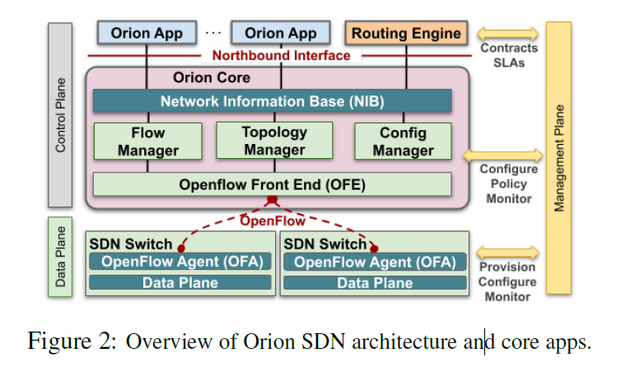
Overview
Orion controls the network through distributed controller processes
NIB provides a uniform northbound interface for Orion applications to share states and communicate requirements.
Forwarding tables, statistics gathering, and event notification

Slide 37
Orion core
Roles
Translate requirements into OpenFlow primitives
Reconcile switches’ programmed state with intended state
Provide a view of the runtime state of the network to applications
Forwarding rules
Statistics
Data plane events

Slide 38
Orion Core
NIB: intent store for all Orion applications
Centralized, in-memory database
Replicas
Requirements
Low external dependency
Sequential consistency of event ordering
Entities
Configured network topology
Network run-time state
Forwarding state, protocol state, statistics
Orion application configuration

Slide 39
Orion Core
NIB API
Read
Write
Subscribe
Basic filtering to express entities of interest

Slide 40
Overview
Orion controls the network through distributed controller processes
NIB provides a uniform northbound interface for Orion applications to share states and communicate requirements.
Forwarding tables, statistics gathering, and event notification

Slide 41
Orion
Config manager
Provide an external management API to configure all components in an Orion domain
Topology manager
Set and report runtime state of network dataplane topology
Flow manager
Flow state reconciliation
Update when intent changes or every 30 seconds

Slide 42
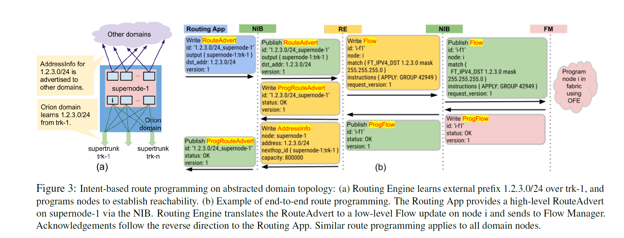
Routing Engine
Provide common routing mechanisms
L3 multi-path forwarding, load balancing, encapsulation, etc.

Slide 43
B4

Slide 44
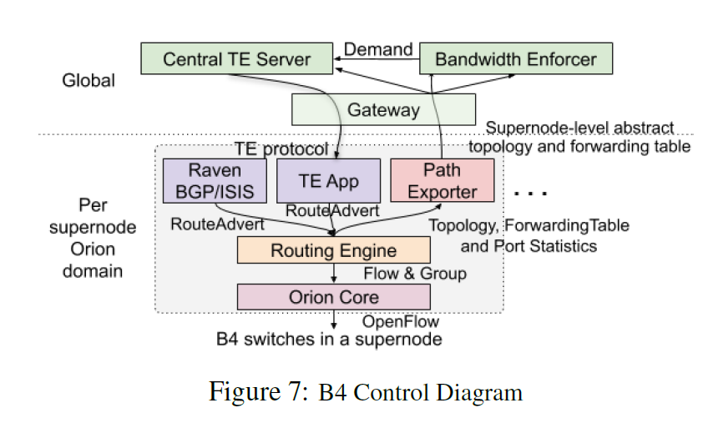
B4 with Orion

Slide 45
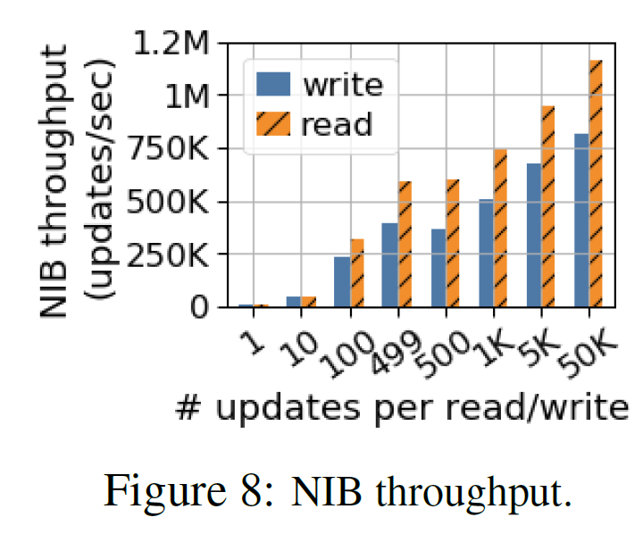
Evaluation
Throughput increases as the batch size becomes larger

